Slide 1
Estimation of networks of bilateral exposures with incomplete data
Prepared by the subgroup on Networks of the LST
Serafín Martinez-Jaramillo

Slide 2
Motivation
Reconstructing networks from partial data is one of the most important yet challenging tasks in network studies
This is important in financial networks in the specific context of contagion analysis and systemic risk
Most of previous studies relied on a common assumption: the maximum entropy (ME) principle

Slide 3
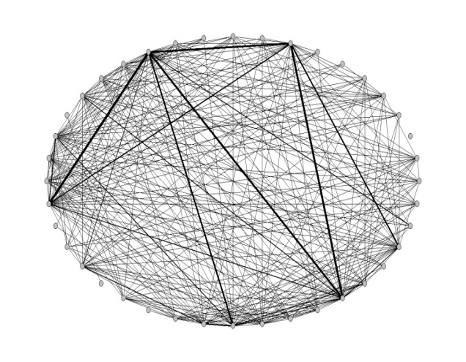
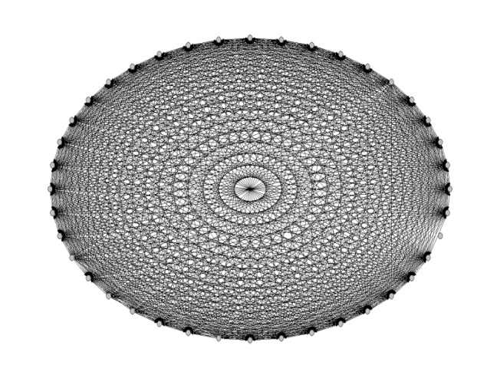
Motivation II
a) Real exposures network | b) ME generated exposures network

Slide 4
Outline
Problem
Objective
Approaches
Horse race
Participants
Conclusions and further work

Slide 5
Problem
Interbank markets are beneficial for excess liquidity transmission in good times, but in the event of large shocks to the financial system, such direct links can work as the propagation mechanism of financial distress
The precise estimation of interbank networks is significant given that it is one of the most important components to evaluate the possibility of direct financial contagion (solvency or liquidity) between financial entities.
There are only few jurisdictions where information on bilateral exposures is available.

Slide 6
Objective
Real exposures
Balance sheet data
Estimated exposures
Marginals

Slide 7
First approach I
Anand, K., B. Craig, G. von Peter (2014), “Filling in the blanks: network structure and interbank contagion”, Discussion Paper No 02/2014, Deutsche Bundesbank.
Combines information-theoretic arguments with economic incentives to produce networks preserving realistic characteristic of interbank networks.
Interbank networks are sparse given that interbank activity is based on relationships. Moreover, previous work by the authors shows that small banks interact with “money center” banks (core-periphery model).
Benchmark model which minimizes the number of necessary links for transmitting a certain volume of interbank loans: a “minimum density” (MD) approach.
The most probable links are identified and loaded with the largest possible exposures, maintaining consistency with the aggregate lending and borrowing for each bank.

Slide 8
First approach II
Important : establishing and maintaining links is costly, banks do not spread lending and borrowing evenly across all possible counterparts because of monitoring costs.
Real interbank networks are sparse and present the phenomena of dissasortative mixing.
The MD approach is formulated as a constrained optimization problem.

Slide 9
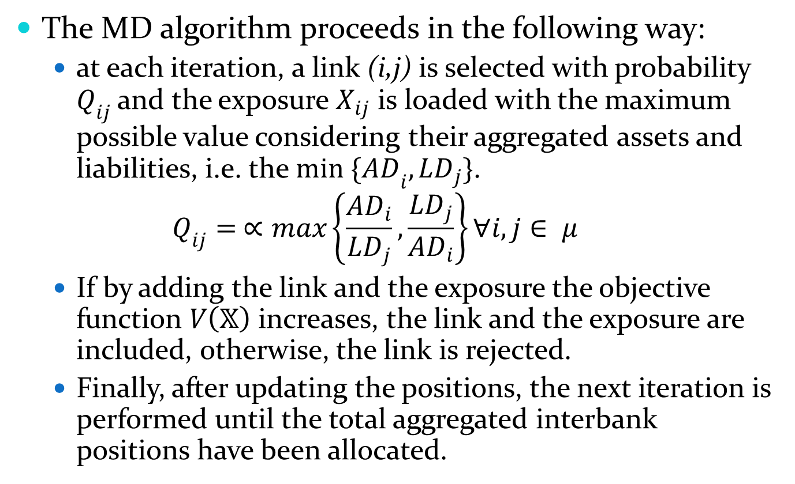
First approach III
The MD algorithm proceeds in the following way:
at each iteration, a link (i,j) is selected with probability $Q_{ij}$ and the exposure $X_{ij}$ is loaded with the maximum possible value considering their aggregated assets and liabilities, i.e. the ${min \{AD}_{i},{LD}_{j}\}$.
$$Q_{ij}= ∝max\left\{\frac{{AD}_{i}}{{LD}_{j}},\frac{{LD}_{j}}{{AD}_{i}}\right\}∀i,j∈ μ$$
If by adding the link and the exposure the objective function $V\left(𝕏\right)$ increases, the link and the exposure are included, otherwise, the link is rejected.
Finally, after updating the positions, the next iteration is performed until the total aggregated interbank positions have been allocated.

Slide 10
Second approach I
Mastromatteo, I., Zarinelli, E., Marsili, M., (2012) “Reconstruction of Financial Networks for Robust Estimation of Systemic Risk”, Journal of Statistical Mechanics Theory and Experiment 03/2012; March 2012.
Explores the space of possible network structures producing worst-case configurations in terms of contagion risk. Tested on simulated data encoding some features of real financial networks
Despite the huge size of the search space, the algorithm is able to sample in a time which scales quadratically in relation to the number of unknown entries of the exposures matrix.

Slide 11
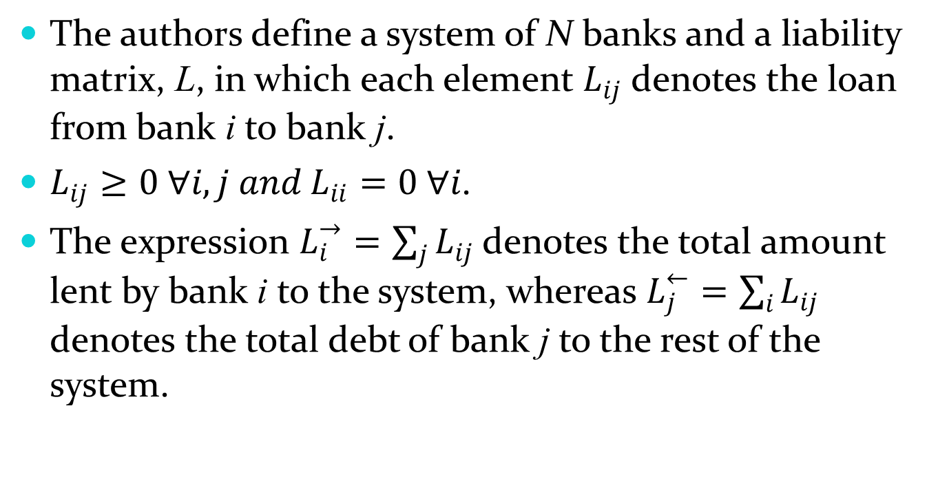
Second approach II
The authors define a system of N banks and a liability matrix, L, in which each element $L_{ij}$ denotes the loan from bank i to bank j.
$L_{ij}≥0 ∀i,j and L_{ii}=0 ∀i$.
The expression $L_{i}^{→}=\sum_{j}{L_{ij}}$ denotes the total amount lent by bank i to the system, whereas $L_{j}^{←}=\sum_{i}{L_{ij}}$ denotes the total debt of bank j to the rest of the system.

Slide 12
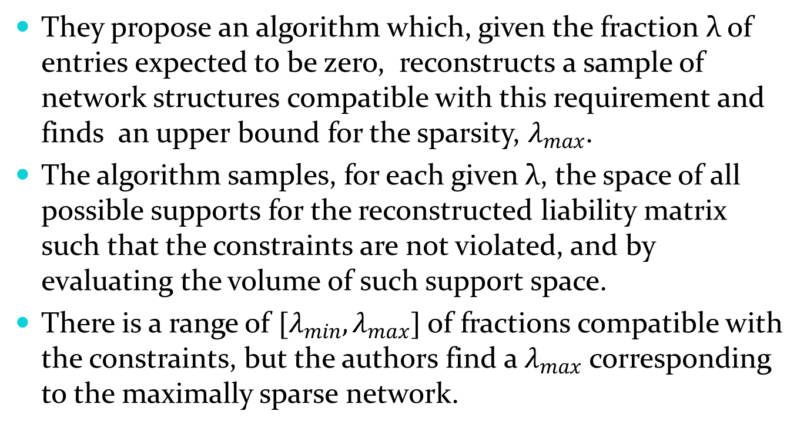
Second approach III
They propose an algorithm which, given the fraction λ of entries expected to be zero, reconstructs a sample of network structures compatible with this requirement and finds an upper bound for the sparsity, $λ_{max}$.
The algorithm samples, for each given λ, the space of all possible supports for the reconstructed liability matrix such that the constraints are not violated, and by evaluating the volume of such support space.
There is a range of $[λ_{min},λ_{max}]$ of fractions compatible with the constraints, but the authors find a $λ_{max}$ corresponding to the maximally sparse network.

Slide 13
Third approach I
Musmeci, N., S. Battiston, G. Caldarelli, M. Puliga, A. Gabrielli, (2013) “Bootstrapping Topological Properties and Systemic Risk of Complex Networks Using the Fitness Model”, Journal of Statistical Physics, May 2013, Volume 151, Issue 3-4, 720-734.
Method to reconstruct global topological properties of complex networks from limited information in which they assume to know the links for a subset of nodes and to know a non-topological quantity (fitness value) for every node.
Degree of subset of nodes in the network is assumed to be known.
Then, a fitness model is used, calibrated on the subset, to generate different networks. The paper, focus on properties which are relevant in contagion processes: density and the k-core structure.

Slide 14
Third approach II
Boostraping Method (BM) which does not aim to reconstruct individual links but focus on estimating global properties.
This method allocates the links between nodes on the basis of a fitness model, which generates network structures starting from non-topological variables associated with the nodes.
Main result: information on the degree of a relatively small fraction of the nodes is enough to estimate the density and k-core structure of the network, only if the fitness of all the nodes is known.

Slide 15
Fourth approach I
Halaj, G., C. Kok (2013). “Assessing Interbank contagion Using Simulated Networks”, Working Paper No. 1506, January 2013, European Central Bank.
Generate interbank networks given incomplete information on bilateral exposures at the European level.
Simulate a large number of interbank networks in order to evaluate contagion effects in the European banking system.
The simulation approach followed by the authors is related to the “Stochastic Block Modeling” of networks.
Link prediction algorithms are used to construct the missing links between nodes in a network.
Allows the authors for departing from ME and from considering only a few snapshots from real interbank networks.

Slide 16
Fourth approach II
Halaj and Kok (2013) approach is based on:
a probability map that a bank in a given country makes an interbank loan to a bank in another (or the same) country
the iterative procedure to generate interbank networks by randomly picking a link between banks and accepting it with a probability taken from the above mentioned probability map
Eisenberg and Noe (2001) clearing payments algorithm for the contagion mechanism

Slide 17
Fourth approach III
The iterative procedure works in the following way:
a random pair of banks is chosen with the same probability and the link is created with a probability given by the probability map.
If the link is created then a random (uniform [0,1]) number is generated which indicates the percentage of interbank liabilities of the first bank from the pair coming from the second bank in such pair, this assignment is consistent with the asset side of the second bank.
This process is repeated until no more liabilities need to be assigned.

Slide 18
Fifth approach I
Halaj, G., C. Kok (2014). “Modeling Emergence of the Interbank Networks”, Working Paper No. 1646, March 2014, European Central Bank.
Departs from their previous work: formation of the interbank network in an endogenous way.
The sequential mechanism is based on a portfolio optimization model where banks allocate interbank exposures considering risk and return relationships and loans are taken considering funding diversification benefits.
Model allows a check on the sensitivity of interbank networks to changes in market-driven parameters as well as to changes in regulation.
Assume that banks optimize their interbank assets considering risk and return as well as regulatory constraints.
Banks define their preferred funding structure with the objective of minimizing rollover risk.

Slide 19
Fifth approach II
Banks participate in a bargaining game in which supply and demand is determined by allowing banks to deviate from their optimal allocations and the prices they offer on them. They propose a four stage sequential process which is repeated until the full allocation of interbank assets is achieved:
Preferred funding structure
Preferred asset structure
Bargaining game
Interest rate adjustment
There are three assumptions of the model:
Banks know each other’s aggregate lending and borrowing
Banks optimize the structure of their interbank assets
Banks prefer diversified funding sources to avoid rollover risk.

Slide 20
Sixth approach I
Moussa, A., (2011), “Contagion and Systemic Risk in Financial Networks”, PhD Thesis, Columbia University.
Given a matrix X₀, the problem is to find a matrix X that is as close as possible to X₀ and satisfying the balance sheet constraints.
If the balancing constraints are feasible, the RAS algorithm converges to the solution of the minimization of the relative entropy subject to the balancing constraints.
It has been proposed to minimize the relative entropy with respect to the non-informative uniform prior.
The authors argue that combining balance sheet data with other sources can aid in reducing this bias.

Slide 21
Sixth approach II
To obtain a scale-free degree distribution network, one can minimize the relative entropy with respect to a sparse prior reflecting our belief on the scale-free structure.
This could lead to an arbitrary network subjectively imposed by the prior.
To solve this, the a priori knowledge of the network structure can be given in the form of a distribution, such as the power law distributions of the in-degree and out-degree or the Pareto distribution of exposures.

Slide 22
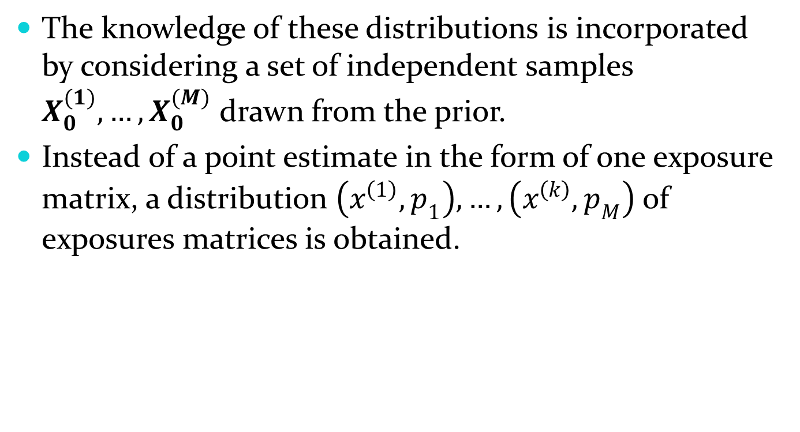
Sixth approach III
The knowledge of these distributions is incorporated by considering a set of independent samples $X_{0}^{(1)},…,X_{0}^{(M)}$ drawn from the prior.
Instead of a point estimate in the form of one exposure matrix, a distribution $\left(x^{\left(1\right)},p_{1}\right),…,\left(x^{\left(k\right)},p_{M}\right)$ of exposures matrices is obtained.

Slide 23
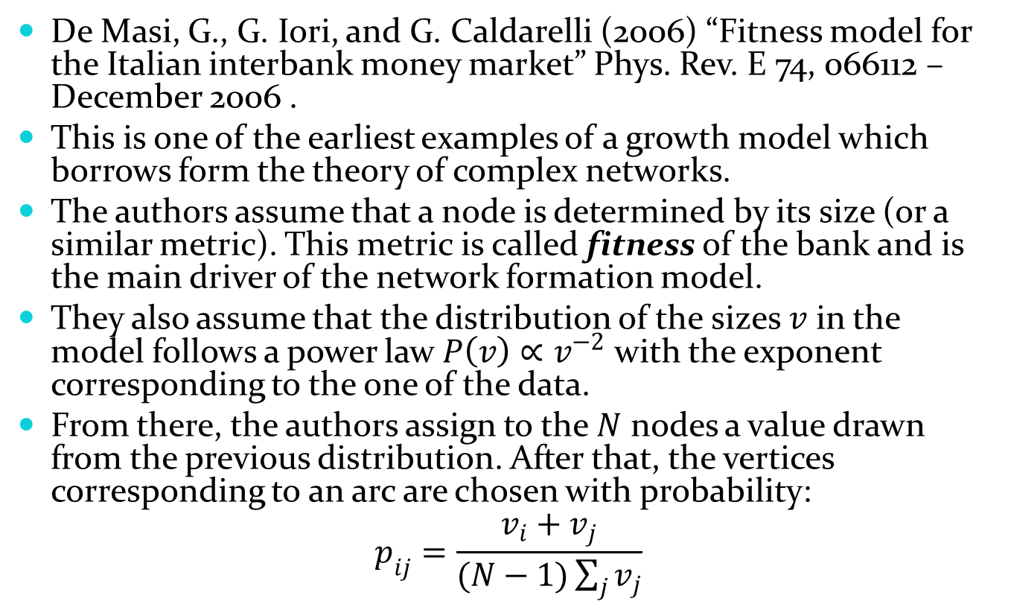
Seventh approach I
De Masi, G., G. Iori, and G. Caldarelli (2006) “Fitness model for the Italian interbank money market” Phys. Rev. E 74, 066112 –December 2006 .
This is one of the earliest examples of a growth model which borrows form the theory of complex networks.
The authors assume that a node is determined by its size (or a similar metric). This metric is called fitness of the bank and is the main driver of the network formation model.
They also assume that the distribution of the sizes $v$ in the model follows a power law $P\left(v\right)∝v^{−2}$ with the exponent corresponding to the one of the data.
From there, the authors assign to the $N$ nodes a value drawn from the previous distribution. After that, the vertices corresponding to an arc are chosen with probability:
$$p_{ij}=\frac{v_{i}+v_{j}}{(N−1)\sum_{j}{v_{j}}}$$

Slide 24
Seventh approach II
This probability reproduces the fact that big banks interact among themselves whereas small banks do not.
Despite the similarity of the fitness model with preferential attachment, they differ in the microscopic procedure. Nodes with large fitness tend to have large degree but this is the result of an intrinsic characteristic (fitness), it is not caused by its connectivity.

Slide 25
Eight approach I
Baral, P., J. P. Fique (2012) “Estimation of Bilateral Connections in a Network: Copula vs. Maximum Entropy”, Mimeo.
The authors propose to use copulas for the estimation of interbank bilateral exposures from incomplete data.
They use the RAS algorithm but instead of treating all the arcs equally, their method uses the values assigned by the copula to generate a stochastic matrix.
The obtained matrix is multiplied by total exposures to estimate the bilateral values. This is done to impose the structure on the network in order to get a better fit.

Slide 26
Eight approach II
The authors base the structure of the construction on the Core-Periphery model.
They define blocks on the bilateral exposures matrix: core to core CC, core to periphery CP, periphery to core PC and periphery to periphery PP
where C is the set of nodes in the core and P is the set of nodes in the periphery.
In cases where there is only information on the marginal distributions a copula can express the dependence structures using the transformed marginals.

Slide 27
Horse race
The proposal is to have a horse race between the different models
For that purpose we have asked the authors of the papers to provide the code used on their papers
So far we have the following codes:
Anand et al
Mastromatteo et al
Halaj & Kok
We are waiting:
Musmeci et al
Moussa
Baral & Fique
De Masi et al

Slide 28
Possible Participants
Korea
Germany
Italy
Brazil √
Netherlands √
Mexico √
US
ECB
Austria
Norway
Denmark
France √

Slide 29
Organisation
Data stays at home, code is shared
For maximum efficiency some standardization will be imposed (eg naming conventions)
Code is in different languages, some adjustment might be necessary
Common outputs:
Matrix, Network measures, Fit
Output to be shared (preserving confidentiality)

Slide 30
Conclusions and further work
Questions:
Is the detail on the note enough or more can be done?
Are there any approaches which should be included or dropped?
Is any of the jurisdictions willing to be included or excluded from this exercise?
Suggestions:
We should not limit the exercise to “simple” topological comparison.
Contagion risk should be studied (DebtRank)
To have a simple, to be defined, exercise on funding contagion would be extremely useful.

